Slide 1
Amazon Fresh Analytics
BY:
SRIMATHI K

Slide 2
Problem Statement
Amazon Fresh is expanding rapidly, creating the need to manage large volumes of data across customers, products, suppliers, orders, and reviews.
The key challenge is to organize this data efficiently to enable insights on top products, customer purchasing patterns, and inventory demand.
Goal: Build a relational database that supports accurate analysis and data-driven decisions.

Slide 3
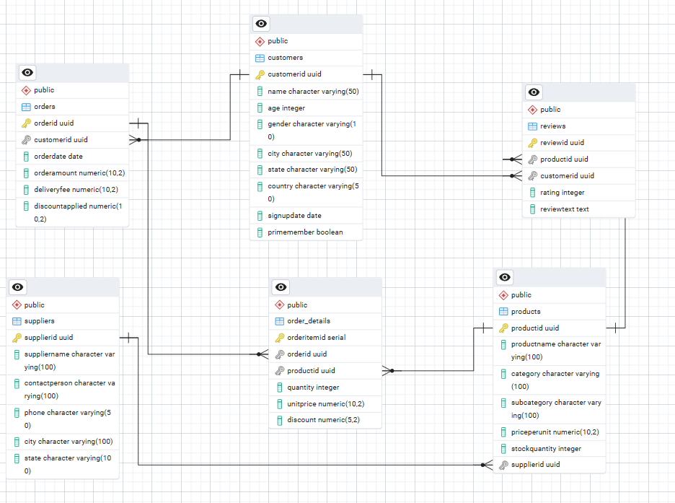
TASK 1 (ER DIAGRAM)

Slide 4
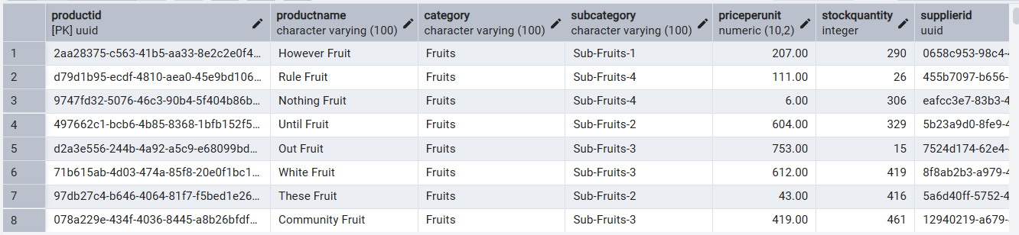
TASK 3(Retreive from city,category)
SELECT *
FROM customers
WHERE City = 'North Daniel';
SELECT *
FROM products
WHERE Category = 'Fruits';

Slide 5
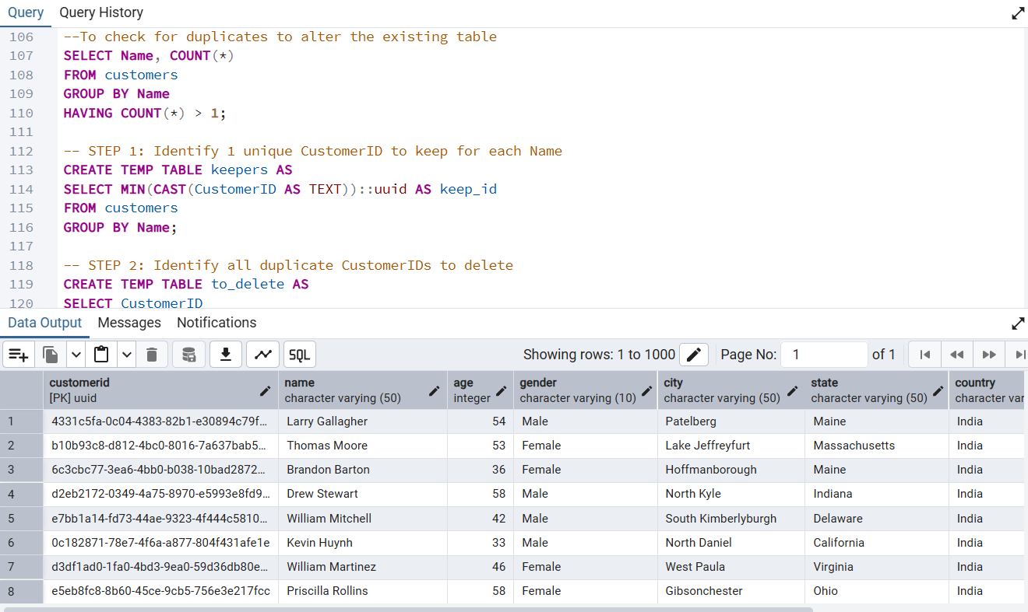
DDL statements –TASK 4
CustomerID as the primary key.
Ensure Age cannot be null and must be greater than 18.
Add a unique constraint for Name.

Slide 6
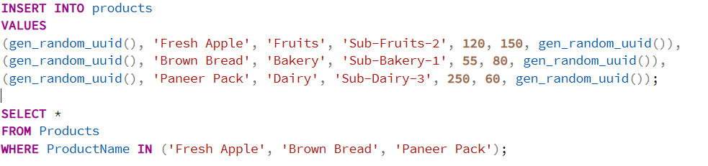
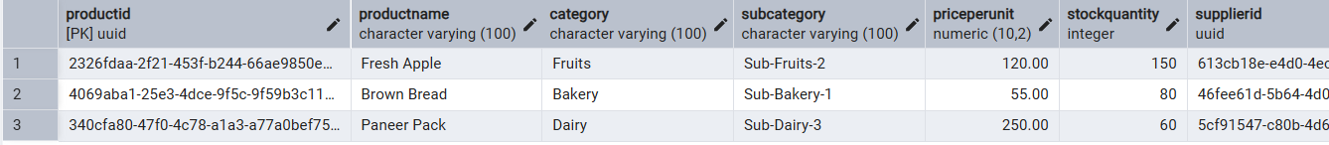
TASK 5 (DML)– INSERT 3 ROWS

Slide 7
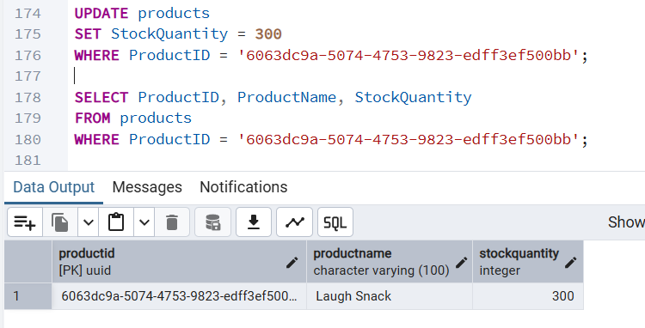
TASK 6 - UPDATE

Slide 8
TASK 7 & 8
7) DELETE FROM suppliers
WHERE City = 'Elizabethside';
Row Deleted Successfully
8)
ALTER TABLE Customers
ALTER COLUMN PrimeMember SET DEFAULT FALSE;
ALTER TABLE reviews
ADD CONSTRAINT chk_rating_range
CHECK (rating >= 1 AND rating <= 5);
Reviews and Customers table altered with conditions

Slide 9
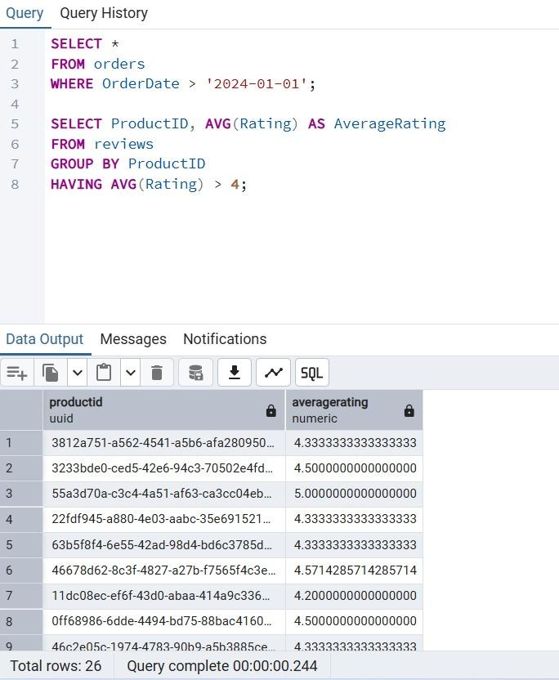
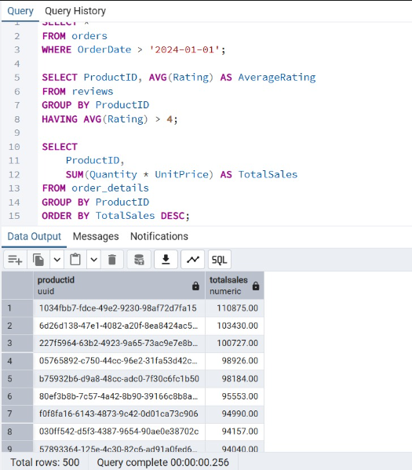
TASK 9 (Clauses and Aggregation)

Slide 10
Insights from TASK 9
1. Order Trends
Orders after 2024-01-01:
Recent demand is rising or falling
You should adjust warehouse replenishment frequency
2. Average Rating
High-rated products:
Should be highlighted on home page
Are ideal candidates for Amazon Fresh private-label items

Slide 11
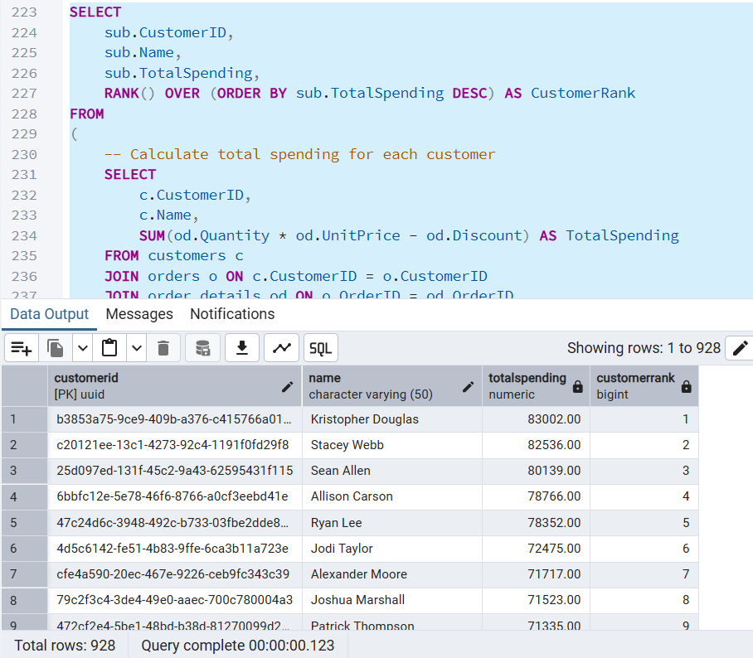
TASK 10 (High Value Customers)
High value Buyers spend around 70,000 to 80,000.
There could be targeted subscription options
Personalized promotion for top customers

Slide 12
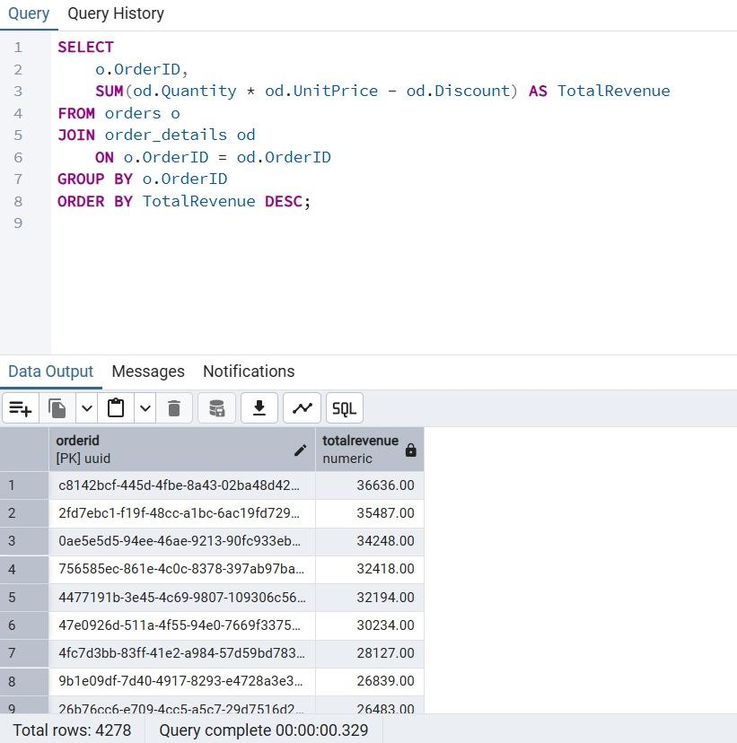
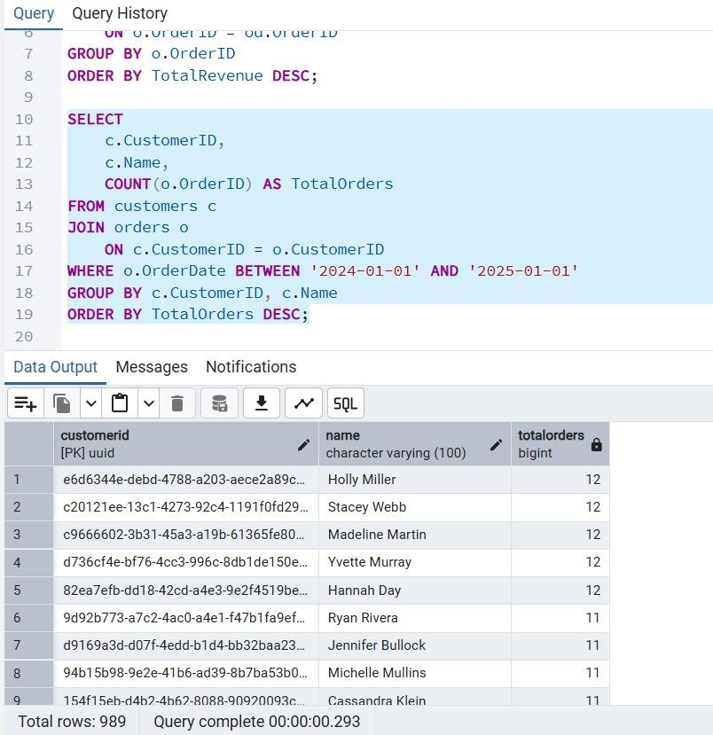
TASK 11 - JOINS
Join the Orders and OrderDetails tables to calculate total revenue per order.
Identify customers who placed the most orders in a specific time period.

Slide 13
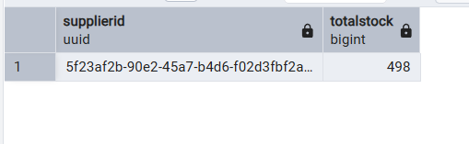
TASK 11(Supplier with most products)
SELECT
SupplierID,
SUM(StockQuantity) AS TotalStock
FROM products
GROUP BY SupplierID
ORDER BY TotalStock DESC
LIMIT 1;
This supplier is the backbone of inventory. Insight:
Must have long-term contracts with them
But need to avoid dependency on one supplier

Slide 14
TASK 12
1) Create new category table
CREATE TABLE product_categories (
CategoryID SERIAL PRIMARY KEY,
Category VARCHAR(100),
SubCategory VARCHAR(100)
);
2) Insert unique category + subcategory
INSERT INTO product_categories (Category, SubCategory)
SELECT DISTINCT Category, SubCategory
FROM products;
3) Add CategoryID column
ALTER TABLE products
ADD COLUMN CategoryID INT;
Separate product categories and subcategories into a new table.
Create foreign keys to maintain relationships.

Slide 15
TASK 12
4) Update CategoryID
UPDATE products p
SET CategoryID = pc.CategoryID
FROM product_categories pc
WHERE p.Category = pc.Category
AND p.SubCategory = pc.SubCategory;
5) Drop old columns
ALTER TABLE products
DROP COLUMN Category,
DROP COLUMN SubCategory;
6) Add foreign key
ALTER TABLE products
ADD FOREIGN KEY (CategoryID) REFERENCES product_categories(CategoryID);

Slide 16
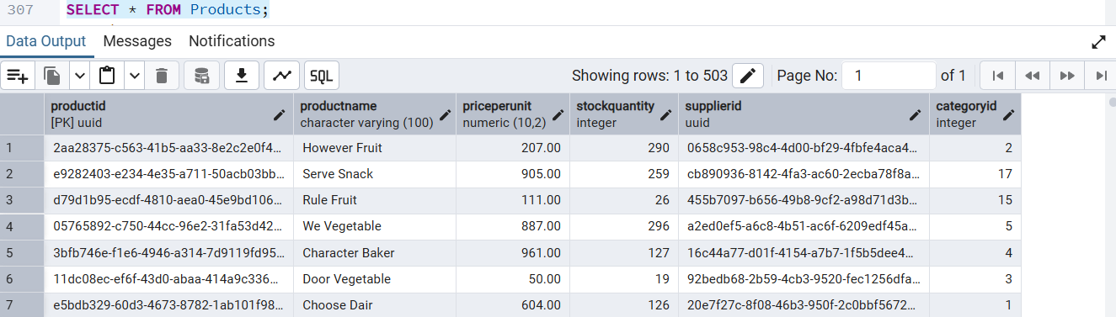
TASK 12

Slide 17
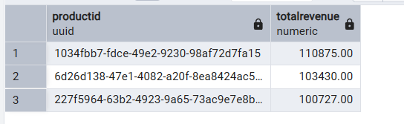
TASK 13
SELECT ProductID, TotalRevenue
FROM (
SELECT ProductID,
SUM(Quantity * UnitPrice) AS TotalRevenue
FROM order_details
GROUP BY ProductID
) AS product_revenue
ORDER BY TotalRevenue DESC
LIMIT 3;
These products drive the majority of sales revenue.
Create bundles using these products to boost average

Slide 18
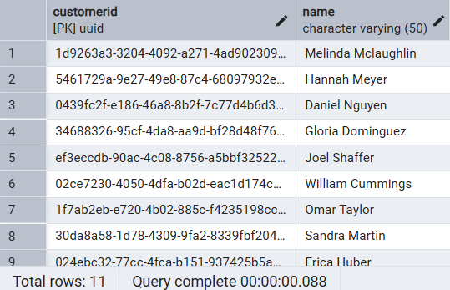
TASK 13
SELECT CustomerID, Name
FROM customers
WHERE CustomerID NOT IN (
SELECT CustomerID
FROM orders
);
These users are leads, not customers yet.
Attract them with welcome discounts

Slide 19
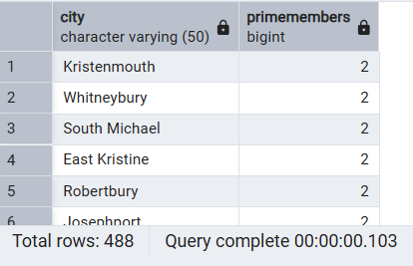
TASK 14
SELECT City, COUNT(*) AS PrimeMembers
FROM customers
WHERE PrimeMember = TRUE
GROUP BY City
ORDER BY PrimeMembers DESC;
Certain cities have higher Prime penetration
These cities may be easier to scale grocery express delivery
Cities with low prime count need marketing push

Slide 20
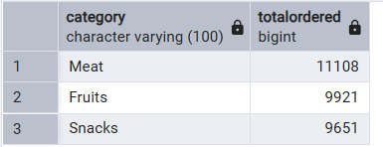
TASK 14
SELECT pc.Category, SUM(od.Quantity) AS TotalOrdered
FROM order_details od
JOIN products p ON od.ProductID = p.ProductID
JOIN product_categories pc ON p.CategoryID = pc.CategoryID
GROUP BY pc.Category
ORDER BY TotalOrdered DESC
LIMIT 3;
Categories with the highest order volumes are in demand
Stock can be consistently maintained in these.

Slide 21
OVERALL INSIGHTS
Top 3 products generate the highest revenue and need priority stock.
Prime members are clustered in specific cities with strong demand.
Several customers have not placed any orders, showing a conversion opportunity.
One supplier provides most of the inventory, creating a dependency risk.
Fruits and Dairy are the most frequently ordered categories based on sales data

